Slide 1
Online Store Analysis
BY Wajiha Ahmed

Slide 2
Today Agenda
Project Recap
Problem
Process
Data Insights
Summary

Slide 3
Project Recap
An online retail store has need a consultant to review their data and provide insights that would be valuable to the CEO and CMO of the business. The business has been performing well and the management wants to analyze what the major contributing factors are to the revenue so they can strategically plan for next year.

Slide 4
Problem
Both CEO and CMO , the executives are interested in viewing and understanding how they can use the data to make more meaningful decisions. The executives want to analyze the trends and the breakdown by different categories so that they have clarity on how the revenue is being generated and what are the main factors affecting the online store.

Slide 5
Process
Data Understanding
Data Cleaning
Data Analysis
Data Visualizations
Data Insights

Slide 6
Insights

Slide 7
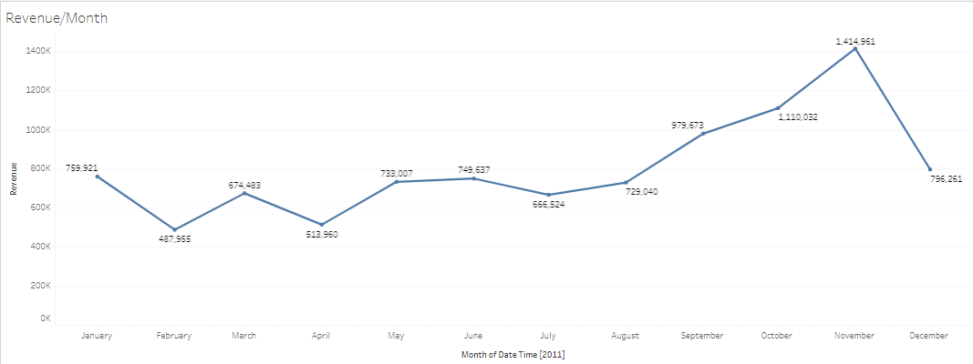
Highest/Lowest Month by Revenue
February has lowest revenue generating month.
December has highest revenue generating month.
Revenue is increasing Continuous from July to December

Slide 8
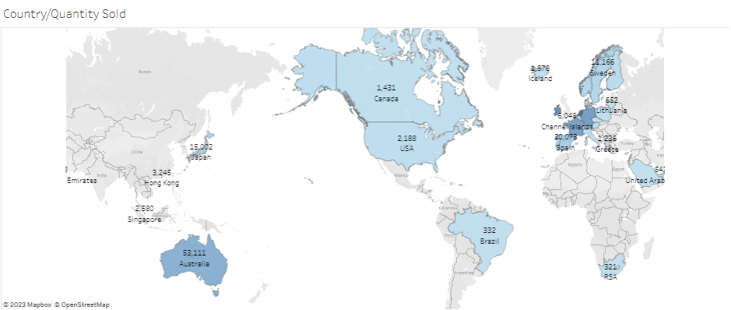
Top Countries for buying Products
Eire and Netherland are among top countries which earn highest revenue of almost 1K.

Slide 9
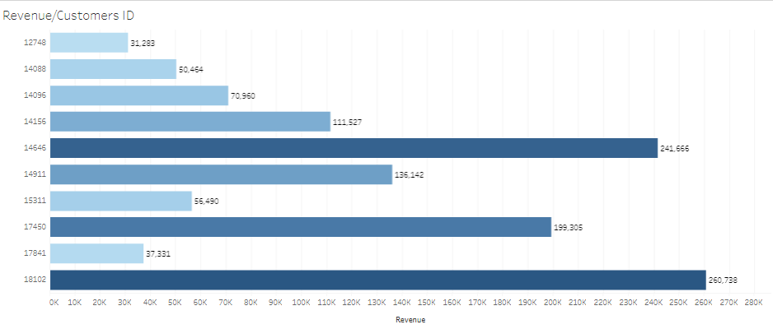
Top 10 Customers By Revenue
Customer ID 18102 has revenue 2.6M and customer ID 14646 has revenue 2.4 M which are among the top revenue generating customers.

Slide 10
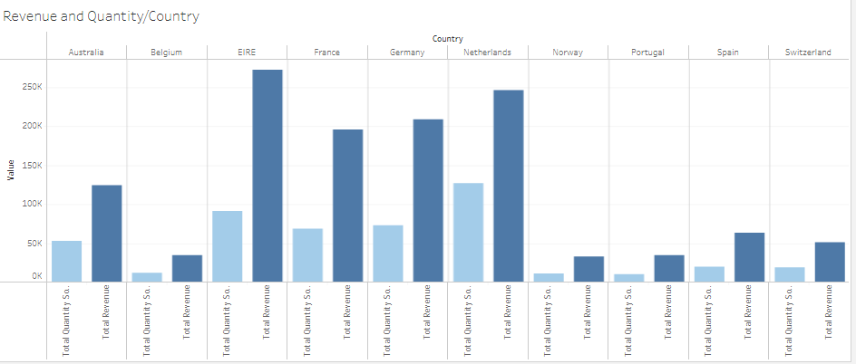
Top 10 Countries by Revenue and Quantity Sold
Eire and Netherland are among top 2 countries that gives highest revenue and buy mostly products.

Slide 11
Summary

Slide 12
Eire and Netherland are among top countries who gives more revenue and buy more quantity of products.
Customer ID 18102 and 14646 are among top revenue generating customers.
December is highest and February has lowest revenue generating months .Their is seasonal trend from July to December.
We highly recommended Retail Store that they consider highest and lowest revenue generating sides of their company to make their marketing strategy. Either they focus more on highest revenue generating sides or make their strategy to up scale lowest revenue generating sides or focus both of them.

Slide 13
Thank You

